Slide 1



ARCHITECTURE OF ELECTRONIC COMPUTING MACHINE & COMPUTING SYSTEMS
Prepared & Presented by: Mirlan Nurbekov, Lecturer
Office hours: Friday 9:00–17:00
AlaToo IT & Business College
Fall 2025

Slide 2

Bluetooth modules in Arduino

Slide 3
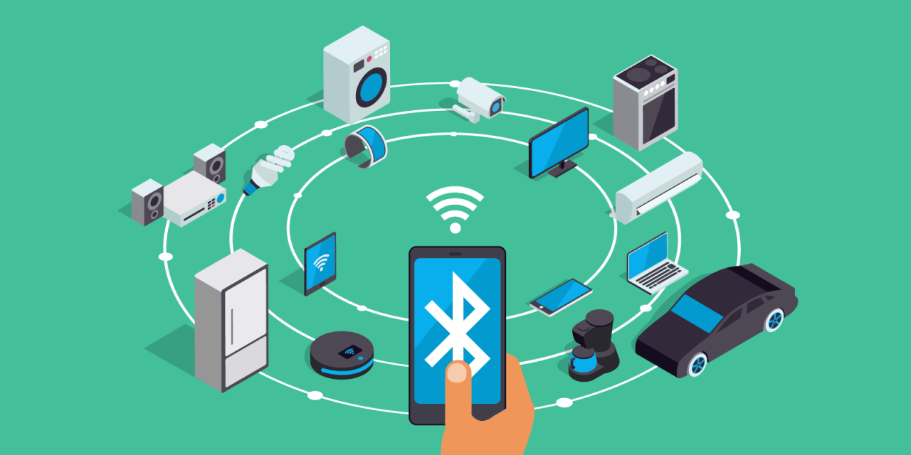
Bluetooth in everyday life

Slide 4
Bluetooth is …
short-range wireless communication
works on 2.4 ghz
allows devices to exchange data
used in phones, earphones, cars

Slide 5
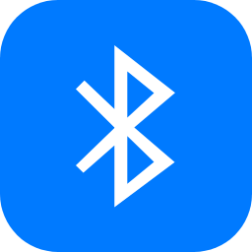
Advantages of Bluetooth
Easy to connect
It does not need internet
Perfect for small projects
Low power consumption

Slide 6
Safety notes
Do not power module with more than 5v
Avoid touching pins when pairing
Always use resistor divider on rx
Check connections twice before you power up

Slide 7
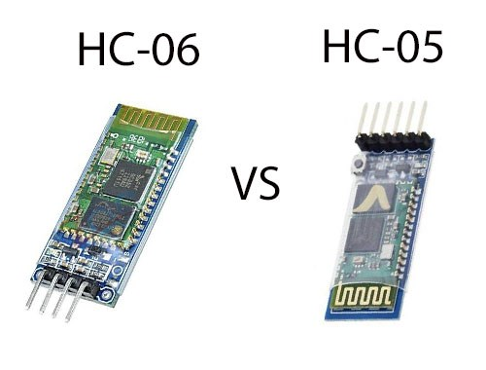
Most popular modules for Arduino

Slide 8
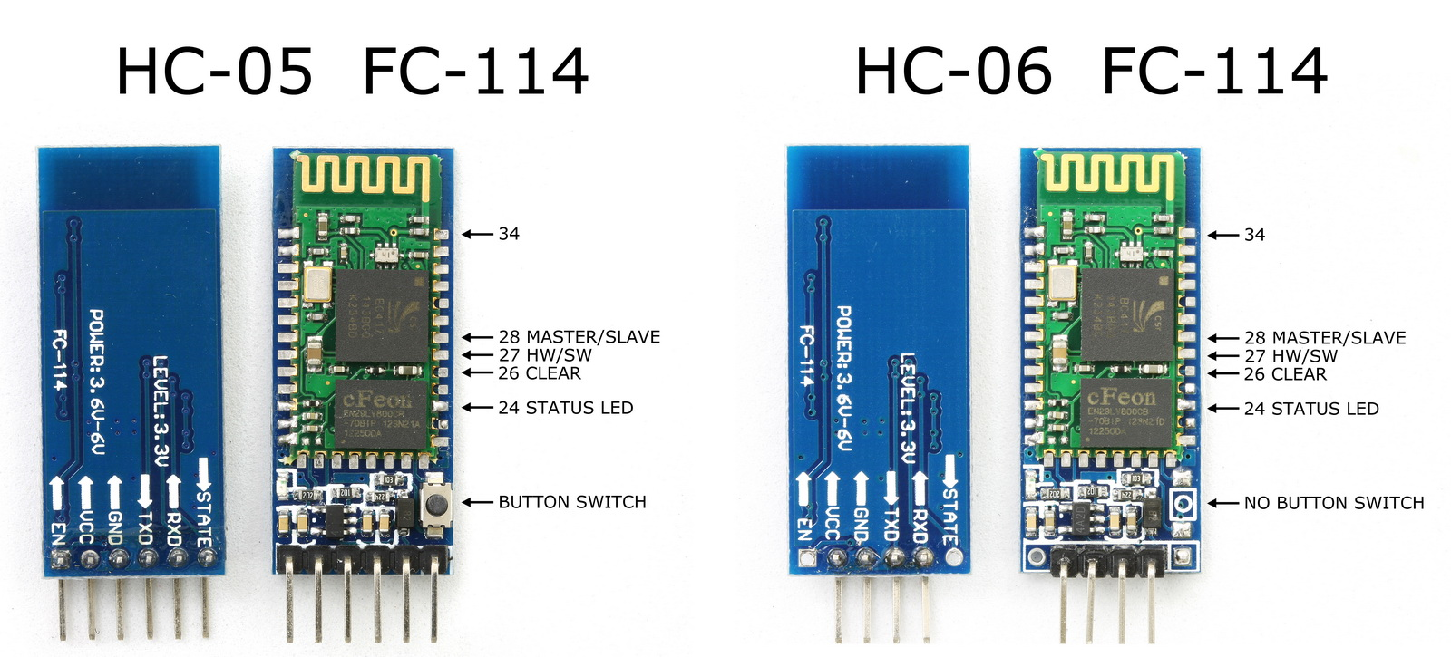

Slide 9
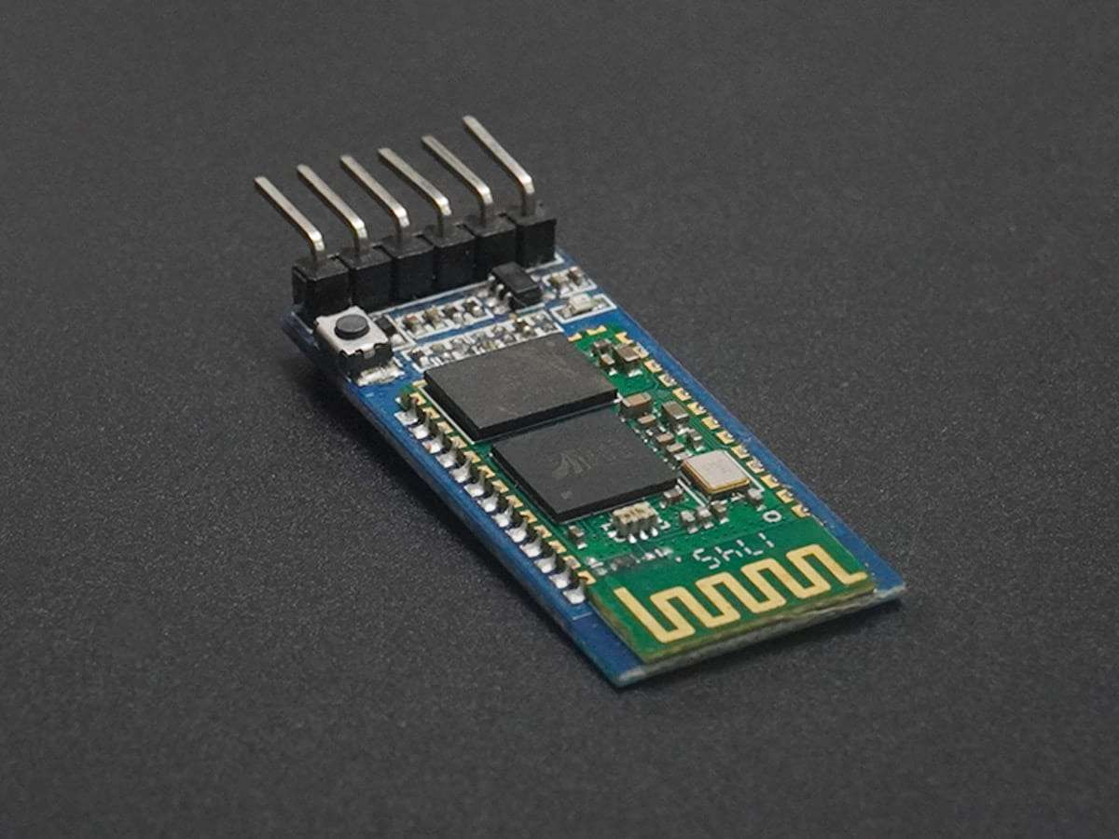
HC-05 overview
Master + slave mode
Default baud:
AT mode factory default: 38400
Communication mode usually: 9600
Can connect to other devices

Slide 10
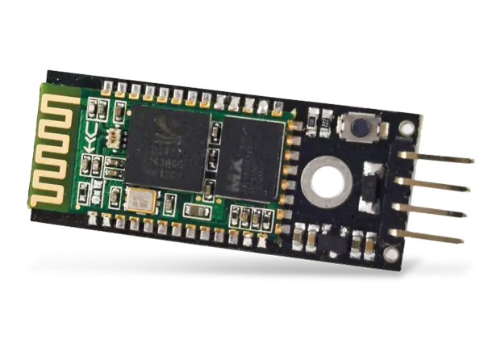
HC-06 overview
Slave-only module
Simple to use
Perfect for simple projects

Slide 11
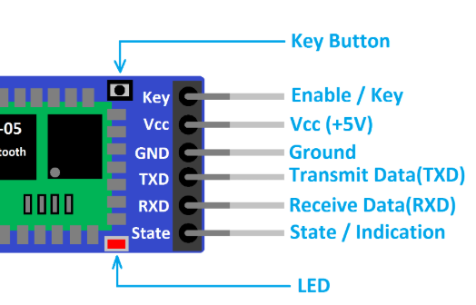
Bluetooth module pins

Slide 12
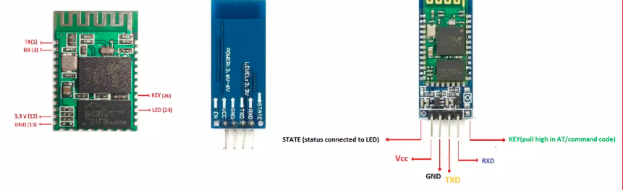
Bluetooth module pins

Slide 13
Communication type
Serial communication
Uses baud rate
Same speed must be set on both sides

Slide 14
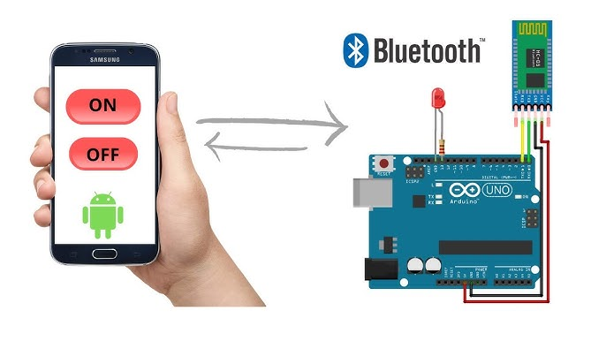
Pairing process

Slide 15
Pairing process
Turn bluetooth on in phone
Find “hc-05” or “hc-06”
Enter pairing code (1234 / 0000)
Connected

Slide 16
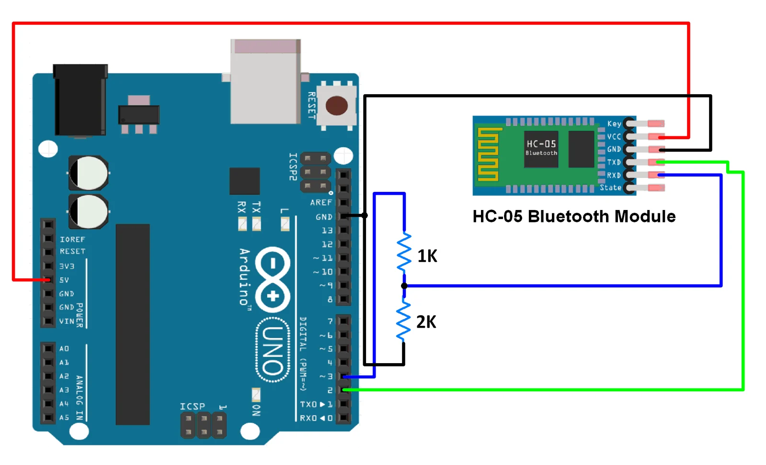
Wiring hc-05 to arduino
vcc → 5v
gnd → gnd
tx → rx (pin 0)
rx → tx
(pin 1, use resistor divider)

Slide 17
Why rx needs a resistor
Arduino tx = 5v
HC-05 rx pin expects 3.3v
resistor divider voltage

Slide 18
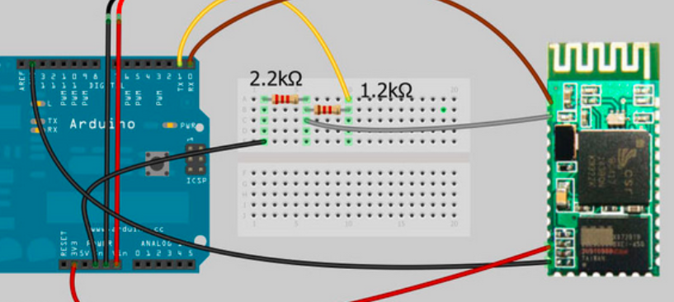
Voltage divider example
1k + 2k resistors
converts 5v → 3.3v
protects bluetooth module

Slide 19
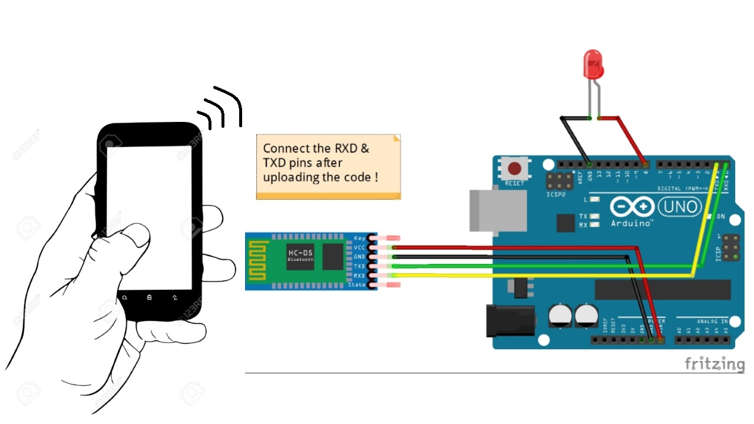
The communication flow
phone → bluetooth → arduino → action

Slide 20

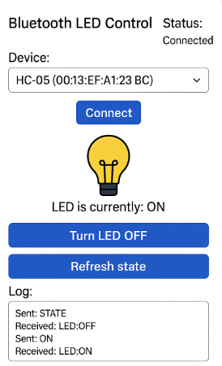
The code
https://github.com/AlaTooMirlanNurbekov/A003_Architecture_of_Computing_Systems/blob/main/0002_codes/0010.ino

Slide 21
How arduino reads bluetooth data
Receives characters
Uses serial.read()
Performs action based on input value

Slide 22
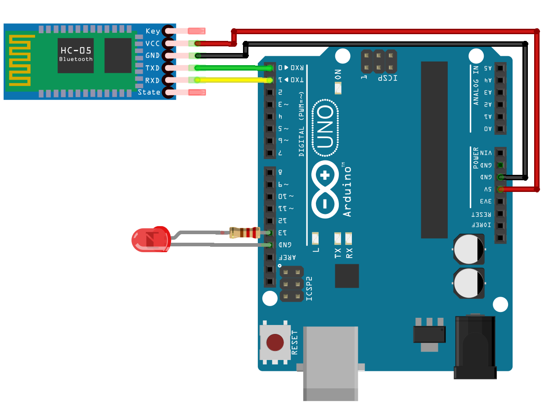
Example
Control led using phone
send “1” → led on
send “0” → led off

Slide 23
Master & slave in bluetooth modules
-Bluetooth communication uses two roles
-Master → the device that starts the connection
-Slave → the device that waits for the master to connect
-Only HC-05 can work as master or slave

Slide 24
Master & slave in bluetooth modules
-HC-06 can work only as slave
-Arduino usually uses bluetooth in slave mode
-Phone acts as master (it initiates pairing)

Slide 25
In simple words it means …
Master scans for nearby bluetooth devices
It finds the slave module (HC-05 / HC-06)
Pairing happens using pin: 1234 or 0000

Slide 26
In simple words it means …
Master opens the serial link
Both sides can now send and receive data
Only one master can connect to one slave at a time

Slide 27
Limitations
Limited range (5-8 meters)
Slower than wifi
Connects one device at a time
Cannot stream video/audio

Slide 28
Range for Bluetooth modules
Class 1 - 25 to 30 meters - industrial long range adapters
Class 2 - 5 to 8 meters - HC-05/HC-06, phone bluetooth modules
Class 3 - 1 to 2 meters - small wearables

Slide 29
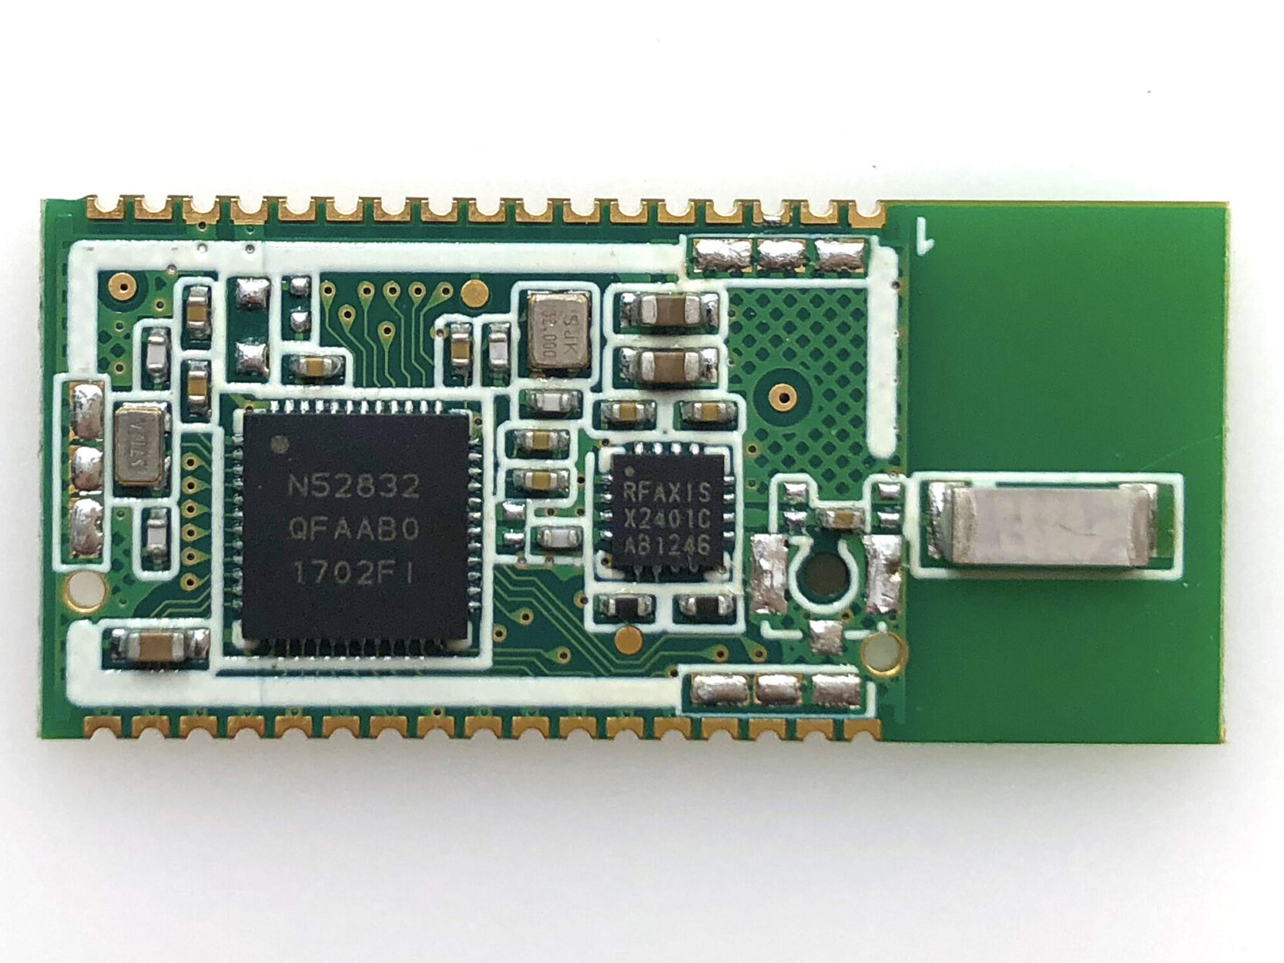
Industrial bluetooth modules
JDY - 40
BTM - 112
SPP - CA
WT12

Slide 30
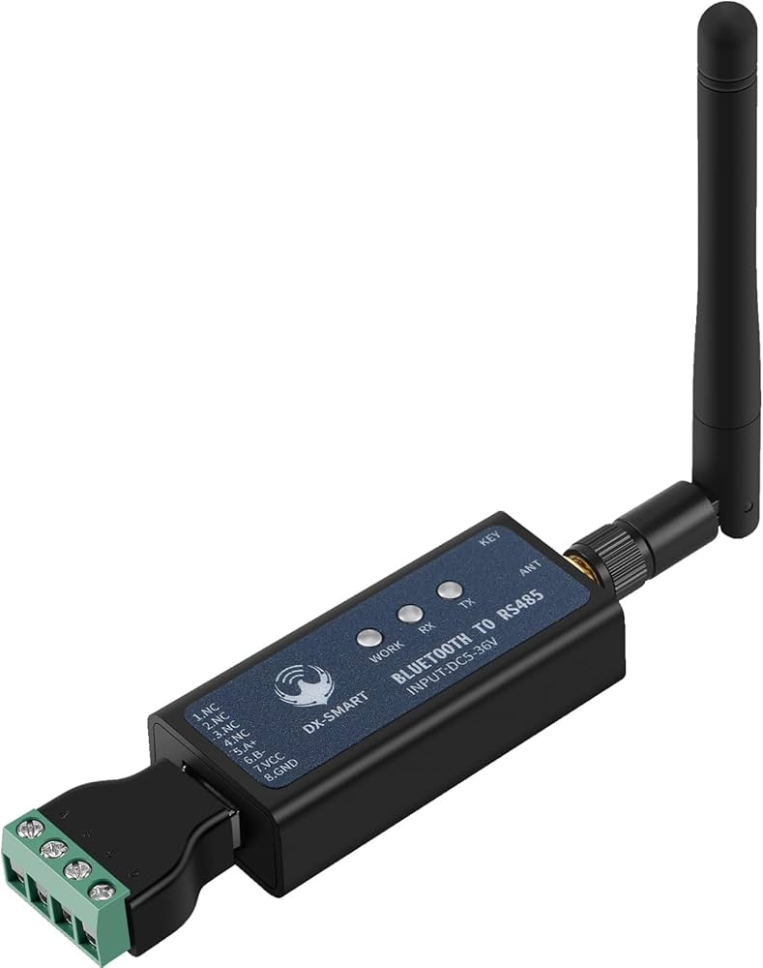
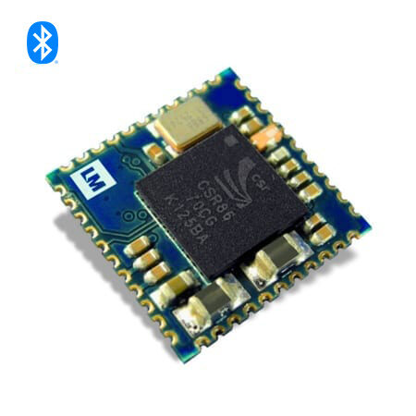
Industrial bluetooth modules

Slide 31
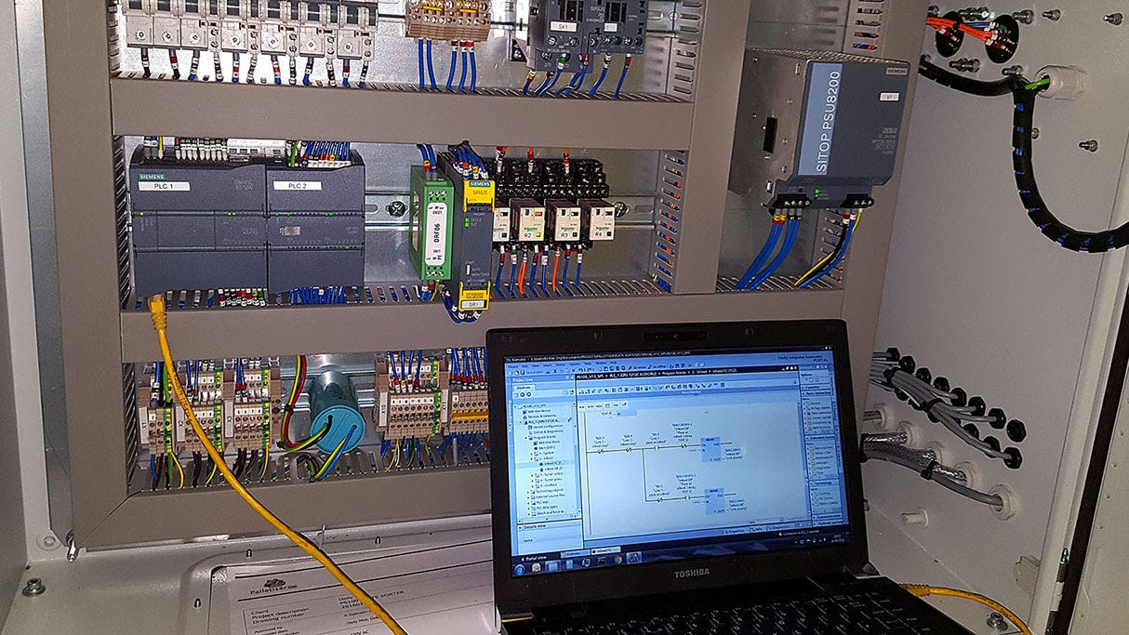
Key characteristics for
industrial models
Built for industrial environments
Operate under electrical noise, heat, vibration
Support Class 1 Bluetooth (up to 30 meters or more)
More stable and secure pairing
Can handle multi-device communication
Designed for PLCs, robots, sensors, conveyors

Slide 32

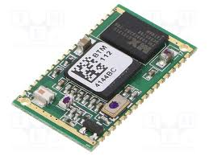
Bluetooth industrial models used
Production lines
Assembly robots
Machine monitoring systems
Remote sensors and meters
Warehouse automation
Industrial AGVs / robot vehicles

Slide 33
Self-test questions
What is the purpose of rx and tx pins?
Why does hc-05 need a voltage divider on rx?
What baud rate do bluetooth modules usually use?
How do you pair hc-05 with a phone?
What does arduino do when it receives “1” from bluetooth?

